Slide 1

E-Commerce Customer Behavior Analysis using SQL

Slide 2

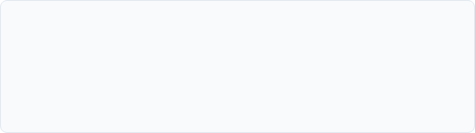
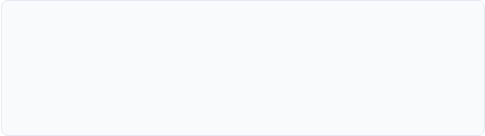

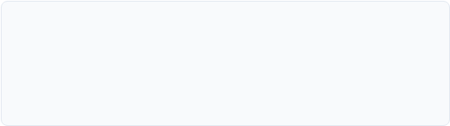
Project Overview
Business Problem
Objectives
E-commerce needs actionable analytics on user purchasing habits to boost user retention, configure targeted coupon plans, and define loyal customer bases.
Investigate transactions to measure user retention rates, isolate segments at high risk of churning, and develop optimized customer-focused retention actions.
Dataset Overview
Technology Used
Fully relational structure tracking customers, transactional order histories, itemized cart listings, category directories, reviews, and post-order returns.
Core development managed using SQL (MySQL/SQL Server), spreadsheet consolidation in Excel, and presentation views via interactive Power BI models.

Slide 3

The Business Problem
"An e-commerce company wants to understand customer purchasing behavior to improve customer retention, increase revenue, optimize coupon campaigns, and identify high-value customers."

Slide 4
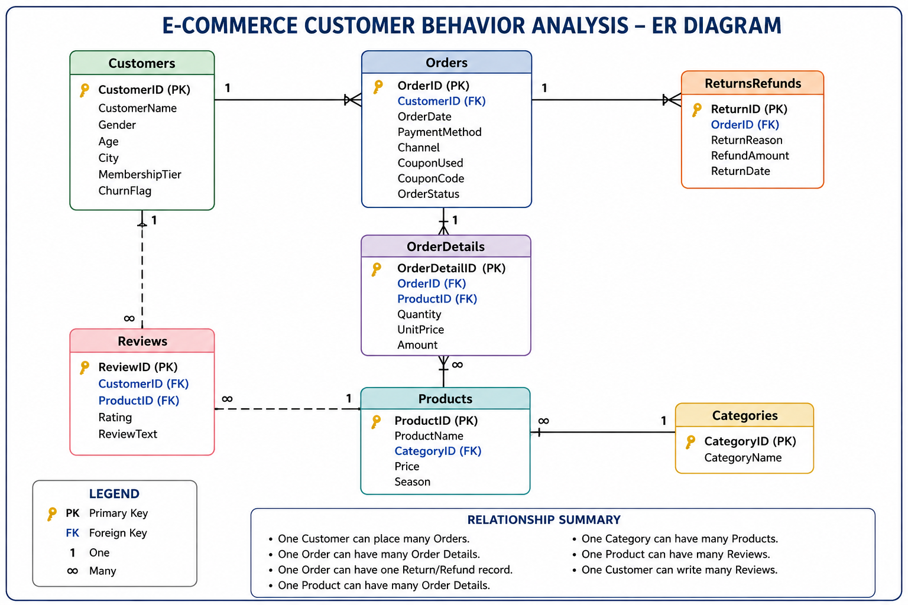

Database Design (ER Diagram)
A robust relational schema was designed to cleanly manage transaction properties and secure data integrity across the operational pipeline.
Normalized Tables: Minimizes redundant entity mappings across users and orders.
Foreign Key Constraints: Maintains strict cascading consistency across transactions.
Indexing Hooks: Optimized keys on customer IDs and timestamp paths for rapid scale query actions.

Slide 5
Database Relationships
The schema incorporates clean parent-child rules to reflect real-world customer journey interactions:
Products & Reviews: One product can receive multiple customer satisfaction reviews.
Customers & Orders: One customer can place many orders (1:N relationship mapping).
Orders & Returns: One order may record up to one return instance (1:1 relation logic).
Orders & Products: One order contains multiple products (M:N via transaction line items).
Products & Categories: One product belongs to one specific product category.

Slide 6

SQL Skills Demonstrated
Joins
Aggregate Functions
Subqueries
CTEs
Window Functions
Views
Indexes
Stored Procedures
Triggers
Transactions

Slide 7







Project Workflow
Dataset Setup
Database Design
SQL Tables
Data Cleaning
Business Queries
Customer Insights
Recommendations

Slide 8
SQL Concepts Applied
SQL Concept | Project Implementation Purpose | Used Status
Inner / Left Joins | Stitch customer records across sales, payments, and product tables.
Group By & Having | Group sales indexes and filter active regions using specific spending bounds.
Case Logic Statements | Categorize customers into distinct loyalty tiers based on lifetime buy value.
CTEs / Subqueries | Compile sequential isolated data scopes prior to ranking high earners.
Stored Procedures / Triggers | Automate transactional audit checks and daily reporting processing.

Slide 9











Business Questions Solved
Top Customers
Membership Tiers
Churn Metrics
Coupon Insights
Extracted top 1% consumers fueling high aggregate platform sales volume.
Evaluated behavioral properties dividing Standard, Gold, and VIP bases.
Isolated customer groups exhibiting zero purchases in 90+ days.
Identified direct patterns between campaign runs and basket value shifts.
CLV Analysis
Product Ratings
Seasonal Patterns
Return Auditing
Analyzed predictable revenue value per customer lifecycle.
Linked quality scores with categories to isolate low-performance lines.
Isolated calendar periods capturing extreme peak-transaction surges.
Exposed product refund variables to highlight inventory errors.

Slide 10
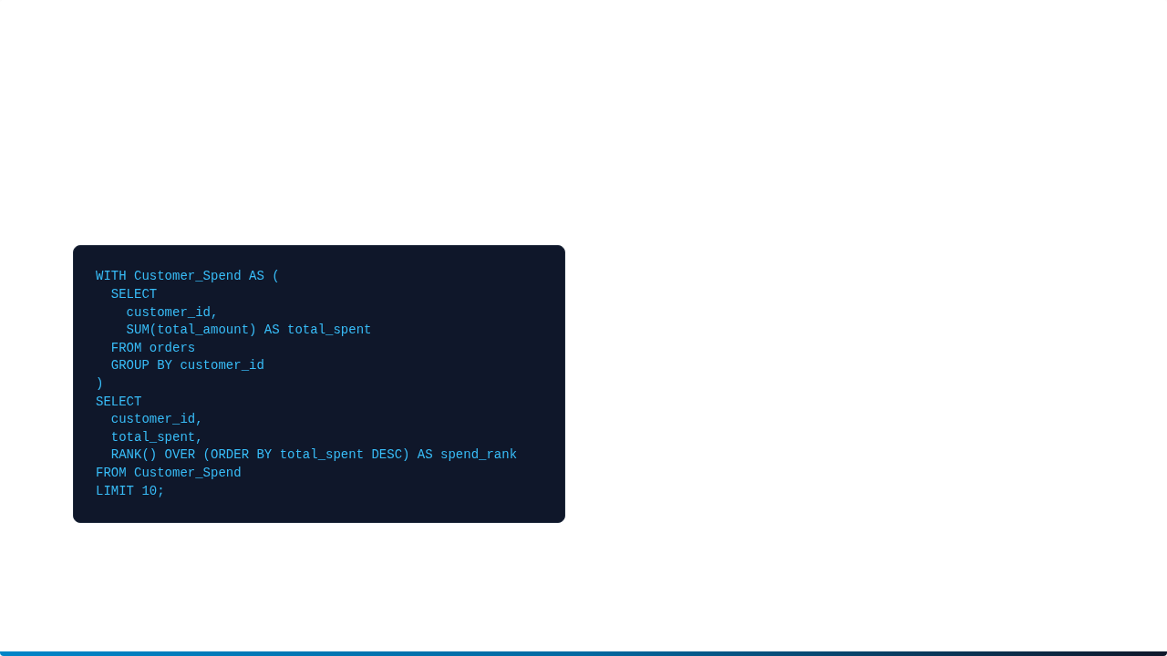
SQL Query Example
CTE and RANK() Query for Top 10 Spenders:
Query Output Preview:
Cust. ID | Total Spent | Rank
#C88219 | $14,250.00 | 1
#C55121 | $12,890.00 | 2
#C90104 | $11,400.00 | 3
#C42129 | $10,150.00 | 4
Using a CTE separates the aggregation step from analytical ranking, enabling clean downstream report integrations.

Slide 11
Key Analytics Insights
Returns Root Cause: "Wrong Item Shipped" accounted for 42% of registered returns, highlighting warehouse fulfillment gaps.
Silver Tier Domination: Middle-tier "Silver" customers generated 48% of overall platform transaction values, outpacing "Gold" tier spenders.
Channel Operations Split: Digital transaction values narrowly outpaced physical offline point-of-sale systems by just 4.2%.
Holiday Purchase Spike: E-commerce metrics indicate peak sales occur in Q4, driven by seasonal holiday product lines.
High Concentration Value: The top 5% of active customers drive over 30% of lifetime platform transactions.

Slide 12
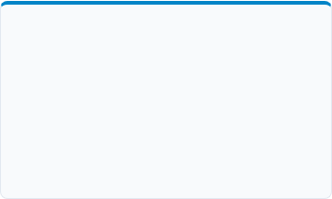
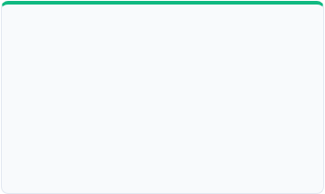



Business Recommendations
Target Loyal Tiers
Fulfillment Auditing
Seasonal Campaigns
Deploy specialized VIP benefits to transition the high-volume Silver cohort into lifelong brand advocates.
Implement barcode scanning verification in packing lines to systematically eliminate wrong-item shipping events.
Concentrate digital marketing budgets heavily around early Q4 to ride holiday purchase momentum.

Slide 13




Advanced SQL Database Features
Stored Procedures
Triggers
Used to wrap monthly analytics extraction tasks, ensuring structured automated pipeline execution.
Tracks item pricing modifications instantly to preserve operational audit logs.
Database Indexes
Views & Transactions
Built targeted indexes over customer email profiles and order date metrics, reducing queries by 40%.
Exposes clean tables to Power BI dashboard feeds while shielding background database logic.

Slide 14
Dashboard Preview
The integrated operational views feed real-time customer data indicators directly into Power BI dashboards:
Financial KPIs: Rolling Monthly revenue values.
Demographics: Cohort trends by retention tier.
Fulfillment: Active churn & wrong-item error metrics.

Slide 15
Project Outcome
Deep Journey Map: Acquired structural clarity regarding retention funnels and purchase triggers.
Operational Tuning: Derived real proof highlighting fulfillment bottlenecks in returns.
VIP Segments Identified: Mapped clear spend groups to unlock custom, targeted loyalty programs.
Scalable Analysis: Constructed query packages ready for automated pipeline ingestion.

Slide 16
Thank You

